Slide 1

Examining the Student Alcohol Consumption
Using Logistic Regression and Clustering
Mind Your Business

Slide 2
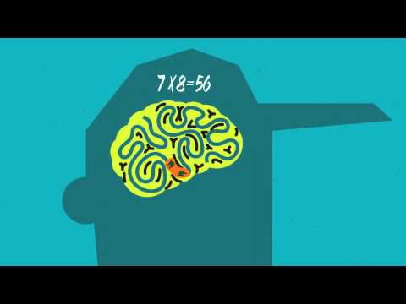

Slide 3
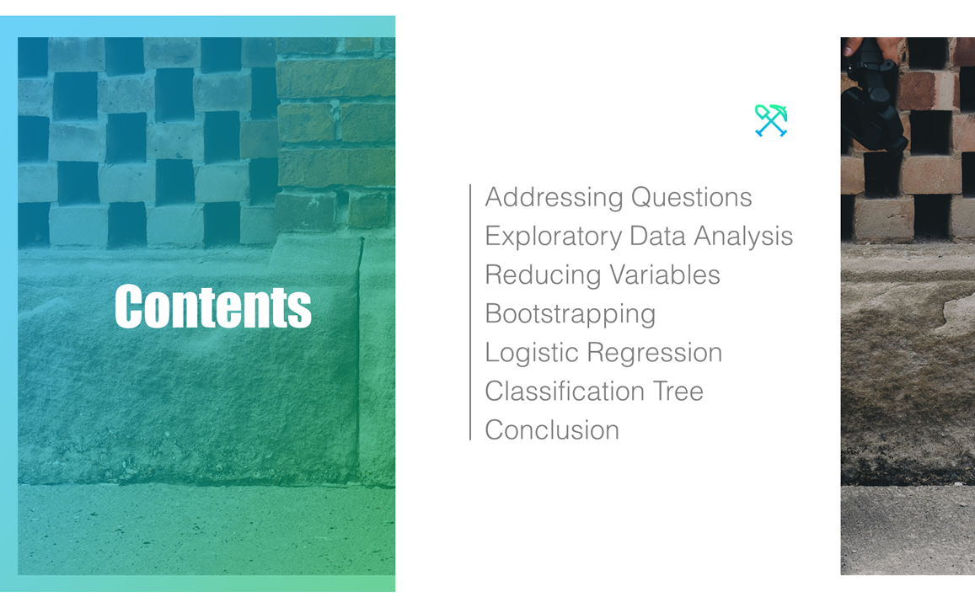
CONTENTS
Addressing the Questions
Exploratory Data Analysis
Reducing the Variables
Logistic Regression
Decision Tree
Bootstrap
Conclusion

Slide 4
Data Source & Questions
Shared by UCI Machine Learning on Kaggle.com
How does students’ personal background (family size, age, gender, etc.), if any, correlated to their alcohol consumption?

Slide 5
Exploring the Data
Survey of high school students in math and Portuguese class
395 Records, 33 Variables

Slide 6
Exploring the Data - Data Structure
Structure of Data
(chart)

Slide 7
Exploring the Data - Summary Statistics
(chart)

Slide 8
Exploring the Data - Plots
(graphs)

Slide 9
Choosing Predictors
Primary Choice
(chart)

Slide 10
Choosing Predictors - Best Subset Selection
Stepwise Regression Function
(chart)

Slide 11
Bootstrap
Why bootstrap:
-limited amounts of data
-Estimate error rate
-the bootstrap approach on our sample containing n = 395 observations.
-each bootstrap data set contains n = 395 observations, sampled with replacement from the original data set.

Slide 12
Logistic Regression
Categorical response variable
Response in two forms:
Weekday Alcohol Consumption (Dalc)
Weekend Alcohol Consumption (Walc)

Slide 13
Logistic Regression - Implementation
Null variable
(picture)
Full variable
(picture)
Used glm() with F = test, direction = “both”

Slide 14
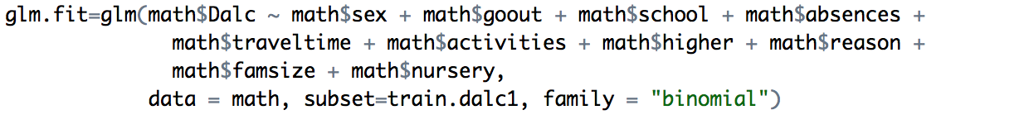
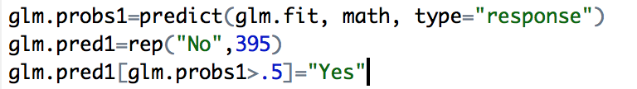
Logistic Regression - Results
Mean accuracy for Weekday model is: 0.9025316
Mean accuracy for Weekend model is: 0.6506329

Slide 15
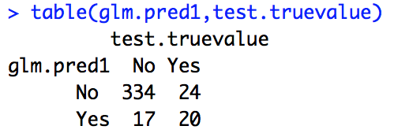
Logistic Regression - Results

Slide 16
Decision Tree
What is decision tree(CART)?(Definition)
Advantages of CART
Simple to understand, interpret, visualize
Variable screening of features selection
Numeric and Category
What predictors we are using for our tree, based on the family background
Famsize(family size) -- LE3: Less or equal to 3; GT3: greater than 3
Pstatus(Parent's cohabitation status) -- T: living together; A: living apart
Medu(Mother’s education) -- 0 - none; 1 - primary education (4th grade);2 - 5th to 9th grade; 3 - secondary education; 4 - higher education)
Fedu(Father’s education) -- Same as Medu
Famsup(Family educational support) -- Yes; No
Nursery(Attended nursery school) -- Yes; No
Famrel(Quality of Family relationships) numeric: from 1 - very bad to 5 - excellent)
Absences(Number of school absences)

Slide 17
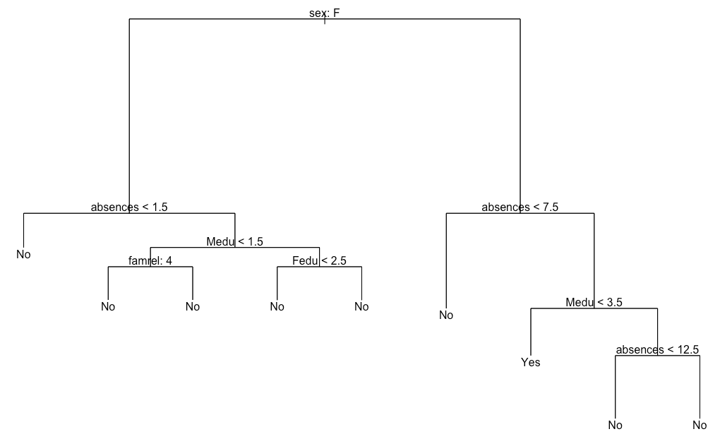
Interpretation(Weekday)
Dalc.test
prunetree.pred No Yes
No 62 10
Yes 6 1
>(Accuracy) mean(prunetree.pred==Dalc.test)
[1] 0.7974684
TreePlot. Pruned Tree with optimal size 9

Slide 18
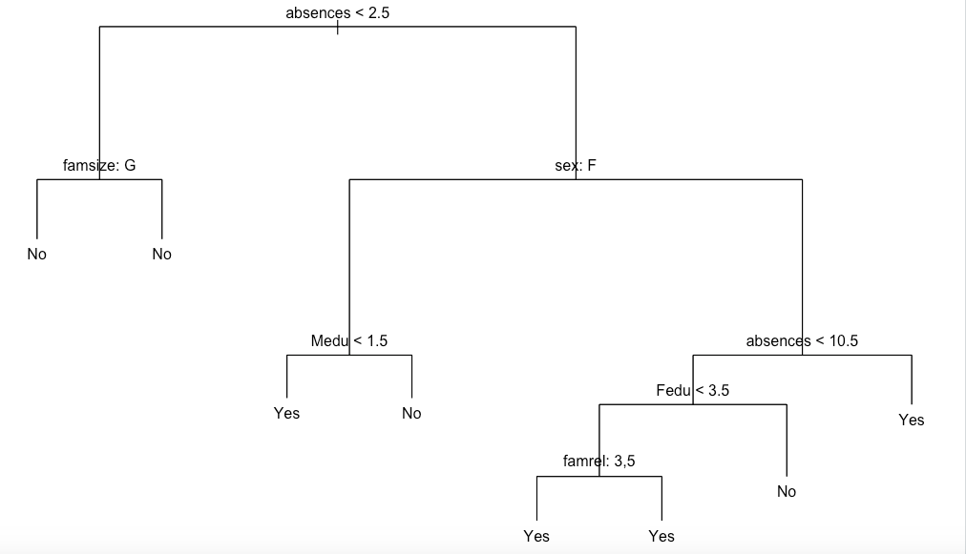
Interpretation(Weekend)
Walc.test
prunetree.pred No Yes
No 35 22
Yes 10 12
> (Accuracy) mean(prunetree.pred==Walc.test)
[1] 0.5949367
TreePlot. Pruned Tree with optimal size 8

Slide 19
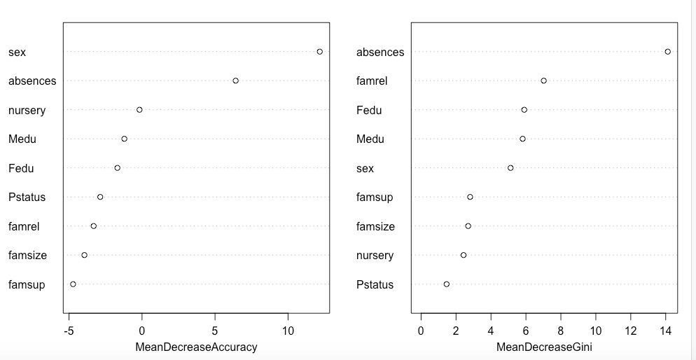
Interpretation(Weekday)
Importance of Variables for Weekday alcohol comsumption tree model
Comparing two graphs on the left, we can conclude that absences, Fedu, Medu, sex, famrel, nursery are these crucial factors cause student to consume alcohol in weekday.

Slide 20
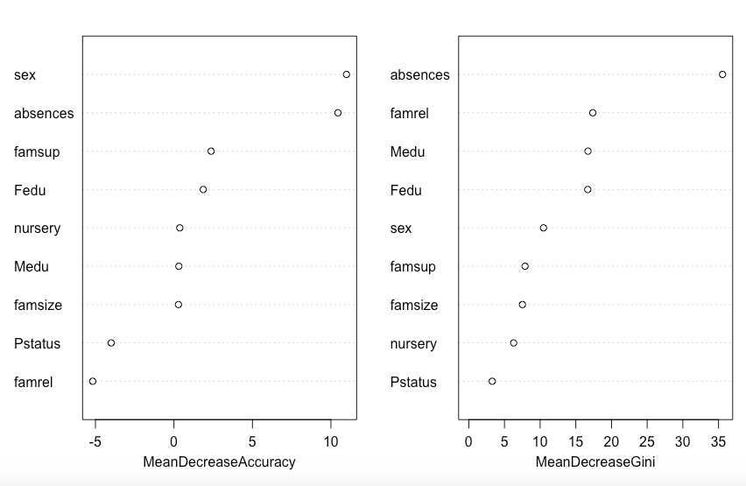
Interpretation(Weekend)
Importance of Variables for Weekend alcohol comsumption tree model.
Comparing two graphs on the left, we can conclude that absences, Fedu, sex, famsup, Medu and famrel are the most important factors cause student to consume alcohol in weekend.

Slide 21
Evaluation of Tree Model
 | Tree | Bagging | Random Forest
Accuracy(Weekday) | 0.7974684 | 0.8101266 | 0.8101266
Accuracy(Weekend) | 0.5949367 | 0.5949367 | 0.6202532

Slide 22
Key Findings
Evidence
“there is evidence suggesting that individuals who are children of alcoholics have a higher probability of becoming alcoholic or problem drinkers as a result of their unstable childhood family systems.” -- Professor Engs, Ruth C, Indiana University studying Family Background of Alcohol Abuse and Its Relationship to Alcohol Consumption among Students
As the decision trees shown on the previous slide.
Family background did have a great influence causes students consume alcohol

Slide 23
So, for our conclusion we developed models using logistic regression and decision tree. Through our findings, we found that logistics regression is the best model and the accuracy was backed up using bootstrap.
Today, alcohol is widely available and aggressively promoted throughout society. We here at Mine Your Business presented you with evidence to support our models. Identifying adolescents at greatest risk can help stop problems before they develop.

